Slide 1
New OnePortal Application

Slide 2
What is OnePortal?
OnePortal is a new parent portal which will enable you to access your child(ren)’s student information and systems, via a single dashboard.
Rather than juggling multiple logins, passwords and systems, OnePortal will merge a range of information from Sentral, Canvas and other platforms into a single place.
It does not replace Sentral or Canvas, but allows you to view your child(ren)’s information such as timetables, teachers, canvas submissions, feedback and school calendar from the same application.
There is a feedback button within OnePortal called “Rate this App” that you can share your experience and feedback with OSG.

Slide 3
What do I need to do?
How do I get access?
  Initial access will be via an email coming shortly to your Sentral registered email address.
  It will contain a link to OnePortal where you will use your Sentral email address to access. You will also be requested to set a password for OnePortal as part of this process.
  If both Parents share the same email, only 1 account will be possible to create. In this instance, if you wish to have your own, you will need to contact your local campus to update Sentral with a unique email address.
Will this change how I access other applications?
  This does not replace any current password to Sentral, Canvas or other applications. We will be working to bring those system passwords together over time where possible. Allowing the same email and password across as many systems as possible.

Slide 4
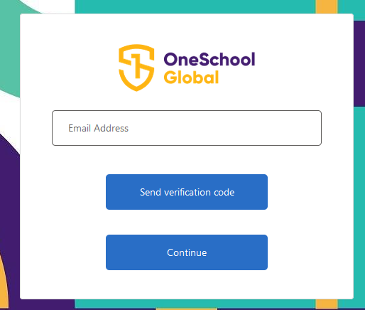
Initial access via email
To setup your OnePortal access, you will receive an email welcoming you to OnePortal that will also contain a link to setup a new email.
The setup process will then require the following:-
Enter your Sentral email address and select “Send verification code”.

Slide 5
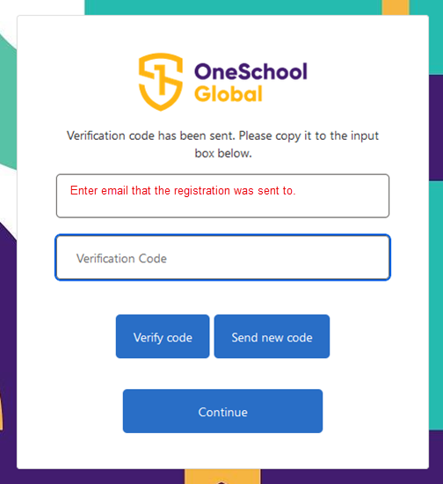
Initial access via email
A verification code will be sent to that email. Enter you email address and the code into the next screen

Slide 6
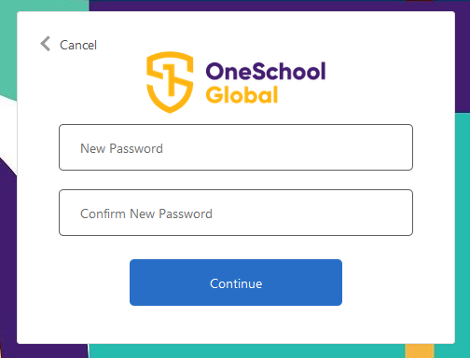
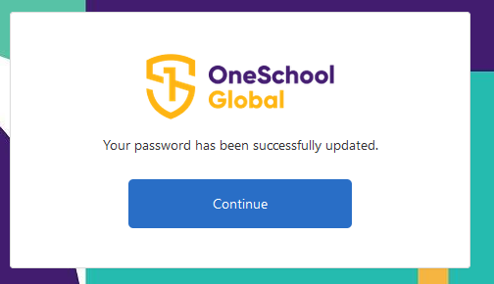
Initial access via email
Select “Continue”, after which you will be prompted to create a new password.
Your password set will then be confirmed.

Slide 7
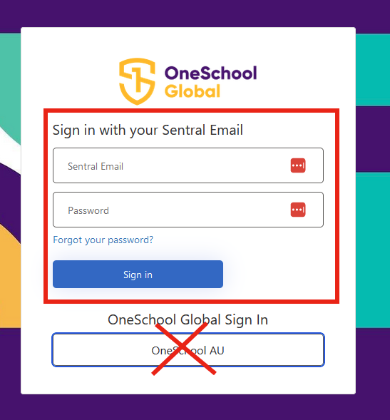
How do I access – web browser and mobile app
The application can be access from a computer via the Web browser at the following address Https://oneportalau.oneschoolglobal.com. This will be emailed to you.
You will be presented with the OnePortal sign on page.
Sign in with your Sentral Email and your set password for OnePortal.
Note: If you have a OneSchool Global volunteer account, you do not use that for this system.

Slide 8
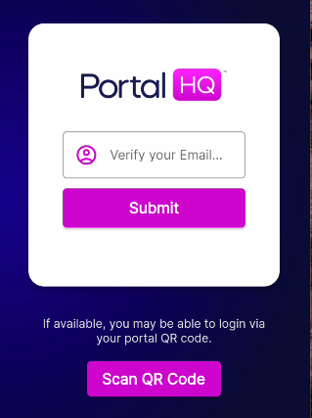
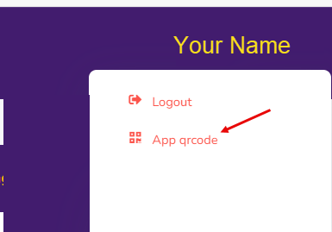
How do I access – OnePortal mobile app?
There is a mobile app to access OnePortal which is called “PortalHQ”. You can download this to your device from the device’s app store by searching for “PortalHQ”.
It is possible it will require streamline approval by your streamline household\business administrator.
Steps:
Open the app once installed. You can access by either verifying your email or scanning a QR code.
Option 1 - Verify your Email
Enter your Sentral email. You will then be presented the login page where you can enter your Sentral email and password you set.

Slide 9
How do I access – OnePortal mobile app?
QR Code Option –
  Open OnePortal in the Web browser
  Go to your profile (top right corner)
  Select “App qr code” and then scan the code with your PortalHQ application. Note that a QR code only lasts 3 minutes before you need to refresh and get a new one to scan.

Slide 10
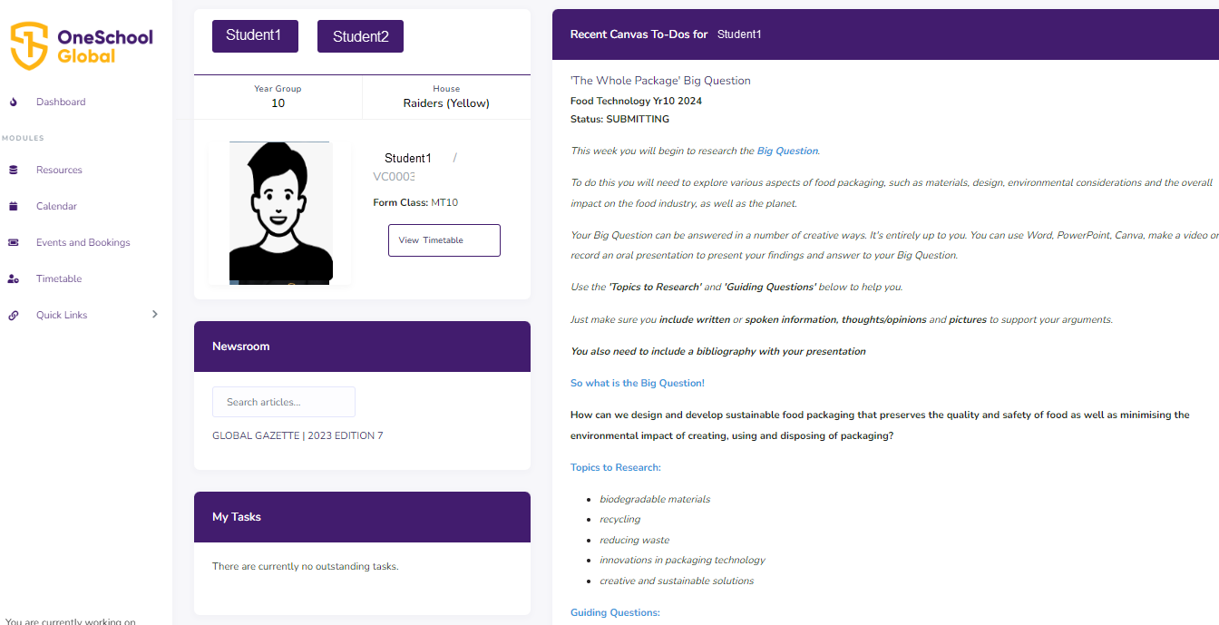
Dashboard – Canvas feeds, Student info

Slide 11
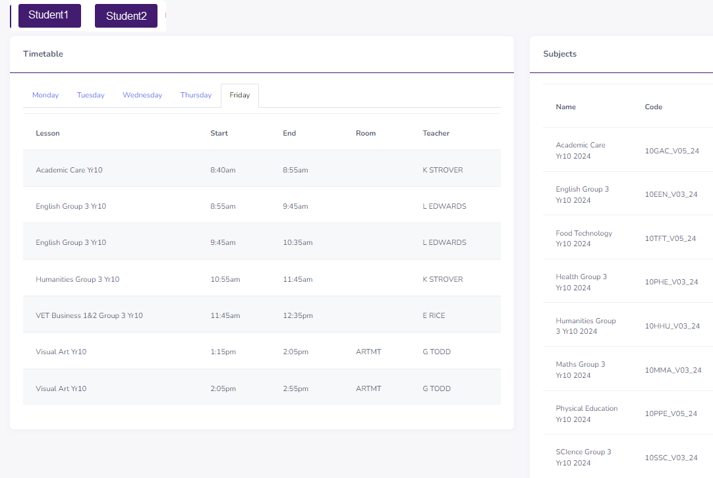
Timetable – Simple to switch between students

Slide 12
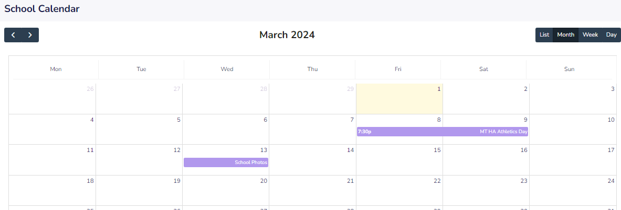
Calendar feed from Sental

Slide 13
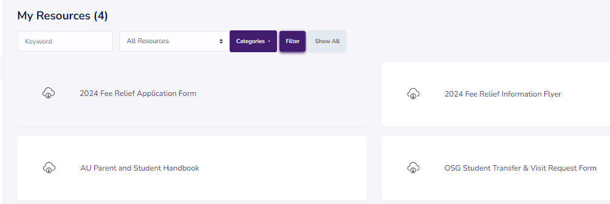
Resource links\Files

Slide 14
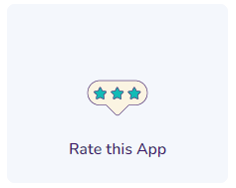
Feedback and reporting incorrect information
We not only value your feedback, but also want to know if you have experienced any challenges with OnePortal or information is not correct. Please use the “Rate this App” button from the dashboard.

